Slide 1
Web Application Hacking
Presenter: Demarcus (shinigami formerly known as vp)
死神

Slide 2
Contents
Web App Basics
OWASP Top 10
SQL Injections
XSS
Tools For Discovering Vulnerabilities
Mitigating Vulnerabilities
DEMO WITH DEMARCUS!

Slide 3
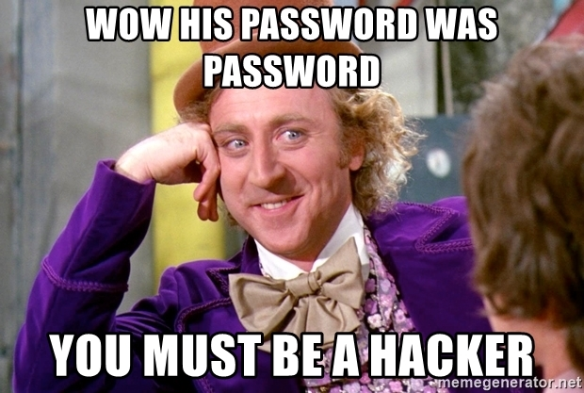

Slide 4
Web Application Basics
Web Applications are essentially web portals written in a web software like php or javascript on a web server. They are different from the software that runs in your kernel or operating system.
Web apps are accessed from your web browser on the Internet and most of the time are public facing. This opens up a huge vector for threat actors!

Slide 5
Sample Web Servers and Common Web Ports
Web Servers
Apache
PythonSimpleHTTPServer
Some web ports to lookout for
Port 80
HTTP
Port 443
HTTPS
Port 8080
Apache used http port

Slide 6

OWASP Top 10
Open Web Application Security Project
This is developed for developers to properly secure their web applications
It is a document of standards for industry best practices towards securing code
The following slides are in order of most/common dangerous vulnerabilities that developers run into
https://owasp.org/www-project-top-ten/

Slide 7
Injection
This includes SQL and LDAP injections
We’ll dig deeper in SQL Injections later
This is an absolute critical vulnerability
Threat Actors can steal entire tables of SQL databases
PII exposed
Passwords and Usernames stolen
Super easy to discover
Scanners will find them with ease or you can just look through code yourself
Look for unfiltered or unsanitized data

Slide 8
2. Broken Authentication
Allowing brute force attacks
No maximum logins allowed parameters set
Use of default passwords
Use of weak or common passwords
Both of these leave yourself vulnerable to dictionary attacks
Unencrypted/plaintext passwords exposed
Identity theft and fraud are common effects of broken authentication

Slide 9
3. Sensitive Data Exposure
PII, healthcare, and financial information are improperly protected
Data is not encrypted in either are transit or at rest
This can cause many problems (these are important to know for CISSP!):
PCI/DSS
HIPAA
GDPR
Data transported in cleartext, so a sight that uses HTTP

Slide 10
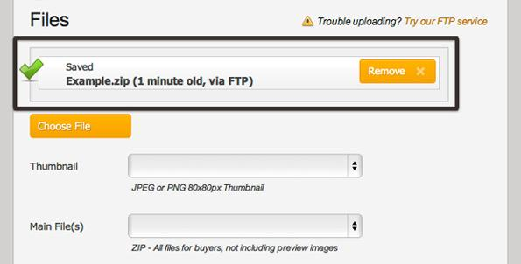
4. XML External entities
Uploading XML or exploiting vulnerable code via XML
Obvious indicators of vulnerability
A website allows for XML files to be uploaded
KEY: Use directory traversal to find an uploads page
In offensive security practice many websites will have an upload page

Slide 11

5. Broken Access Control
JSON Web Token replays
Awesome Lab on Pentesterlab to try
Replaying or tampering with a cookie
Privilege escalation
User on a webpage with admin privileges
A user can then modify or take any record

Slide 12
6. Security Misconfiguration
Extremely common with under resourced IT staffs
Unneeded services installed
Default accounts
Admin/admin
Tomcat/tomcat
Unpatched or legacy software being used with known vulnerabilities

Slide 13
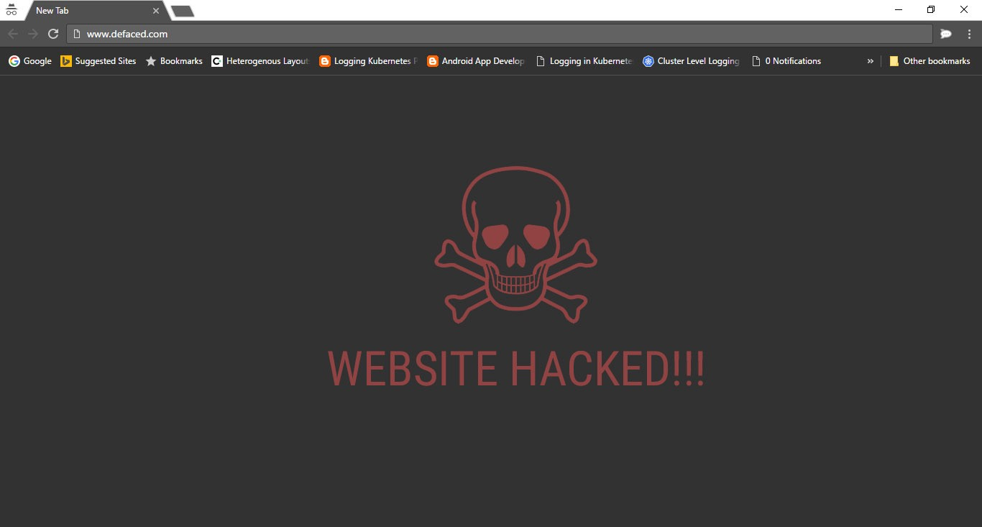
7. Cross Site Scripting
Three types:
Stored XSS
Critical!
Reflected XSS
DOM XSS
Typical attacks
Bypassing two factor authentication
Defacement
Session stealing

Slide 14
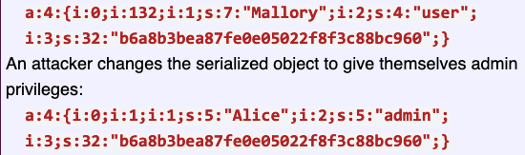
8. Insecure Deserialization
Difficult for attackers to discover
These leads to remote code execution
Example:
https://owasp.org/www-project-top-ten/OWASP_Top_Ten_2017/Top_10-2017_A8-Insecure_Deserialization

Slide 15
9. Using Components with Known Vulnerabilities
Goes a lot with Security Misconfiguration
Outdated, unsupported software
Common when there isn’t proper risk assessments
Proper Patch Management
Independent Verification and Validation can easily discover vulnerabilities
Creating a new update with a known vulnerability and still pushing the functionality update out
More common than you would think

Slide 16
10. Insufficient Logging and Monitoring
Logging is the most important task for blue teamers
First step in moving towards finding indicators of compromise
Monitoring login attempts
Monitoring how much data is withdrawn from a website and/or its database
“In 2016 identifying a breach took an average of 191 days to detect…”
If you can’t detect a threat actor you’ll never know they stole all of your data
Large transactions go unmonitored
Verbose Errors
https://owasp.org/www-project-top-ten/OWASP_Top_Ten_2017/Top_10-2017_A10-Insufficient_Logging%252526Monitoring

Slide 17
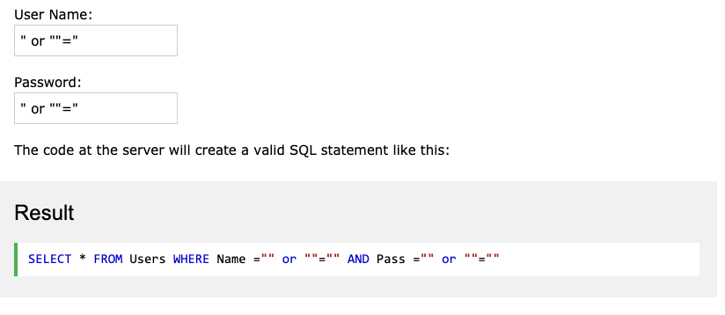
SQL Injections
https://www.w3schools.com/sql/sql_injection.asp

Slide 18
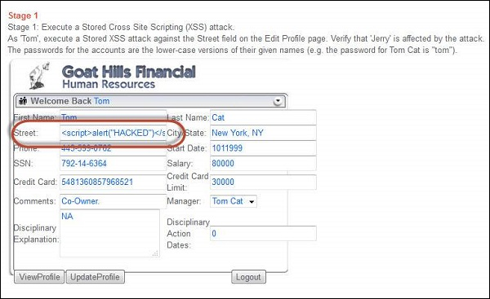
Cross Site Scripting XSS
https://www.tutorialspoint.com/security_testing/testing_cross_site_scripting.htm

Slide 19
Web App Vulnerability and Exploitation Tools
Burpsuite
Nikto
SQLmap
Directory Traversal
Gobuster
Dirbuster
Dirb

Slide 20
Web App Mitigations
Input Validation
Don’t allow certain special characters
When you don’t need data DELETE IT!
A credit card shouldn’t always be stored
This can negate Sensitive Data Exposure
Log all login attempts
Enforce Password change and length policies!
Patch known vulnerabilities

Slide 21
Good Places to Practice
Mutillidae OWASP
Excellent to practice with
Vulnhub
Tryhackme
Pentesterlab **
VirtualHackingLabs
DVWA

Slide 22




OWASP WebGoat

Slide 23
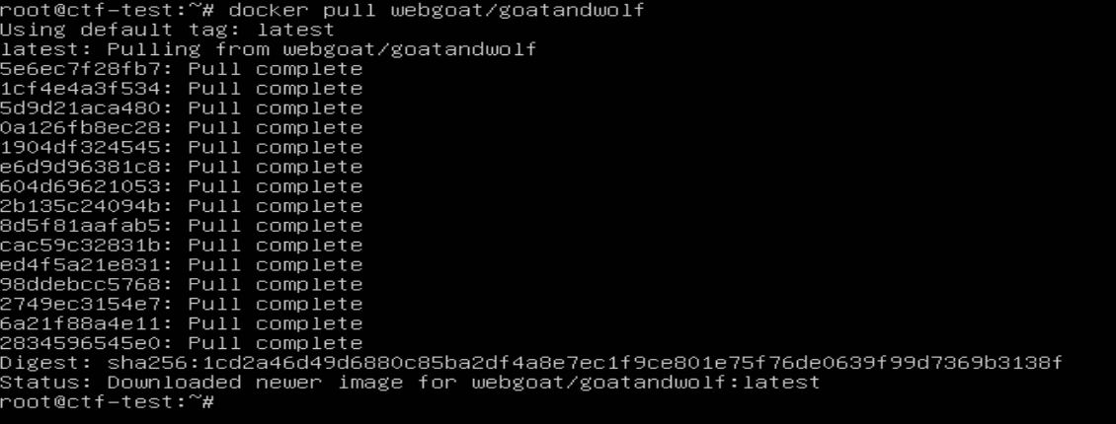
Installing OWASP WebGoat

Slide 24
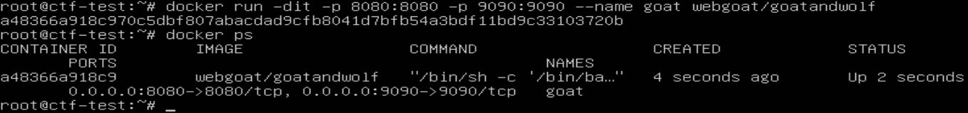
Running OWASP WebGoat
Notes:
Don’t forget to mention `-e TZ=America/Chicago`

Slide 25
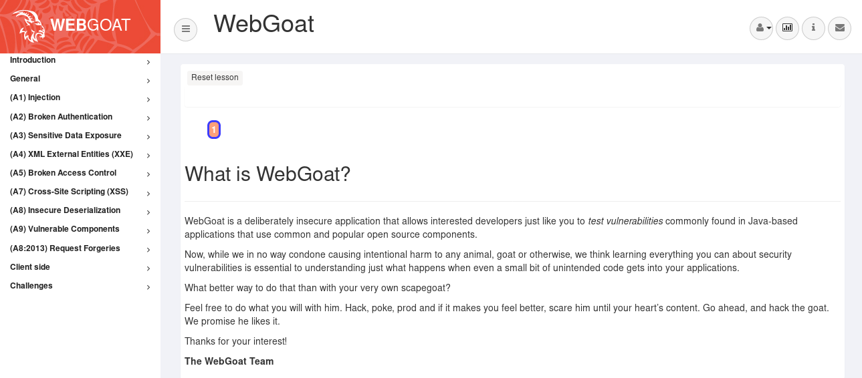
OWASP WebGoat

